Slide 1
Mackinac Bridge
By Vibha

Slide 2
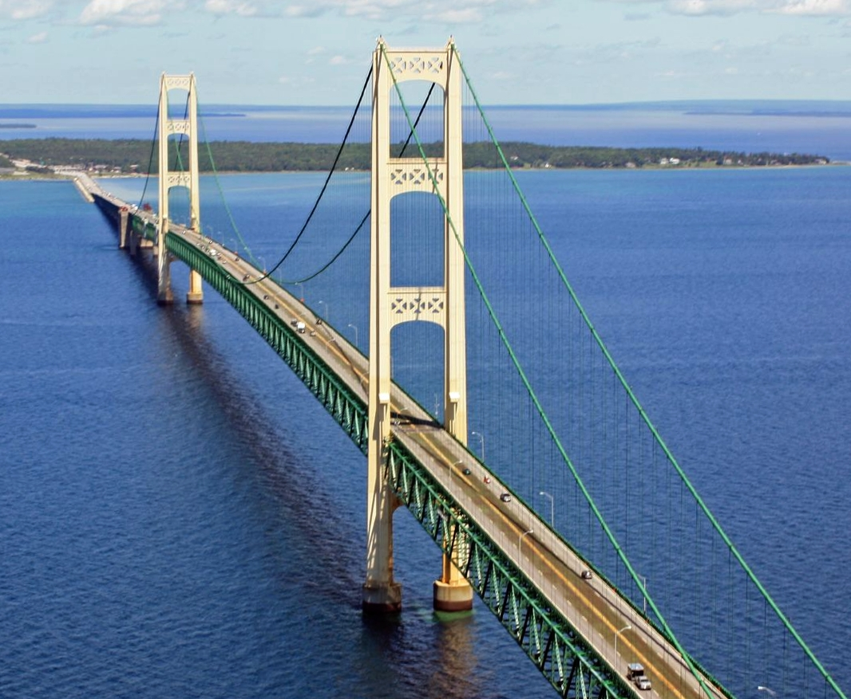
Measurements
Length is 5 miles
26,372 feet
552 feet from water

Slide 3
Interesting Facts
Weigh’s 1,024,500 tons
There are 12,580 wires in bridge
Fifth longest suspension

Slide 4
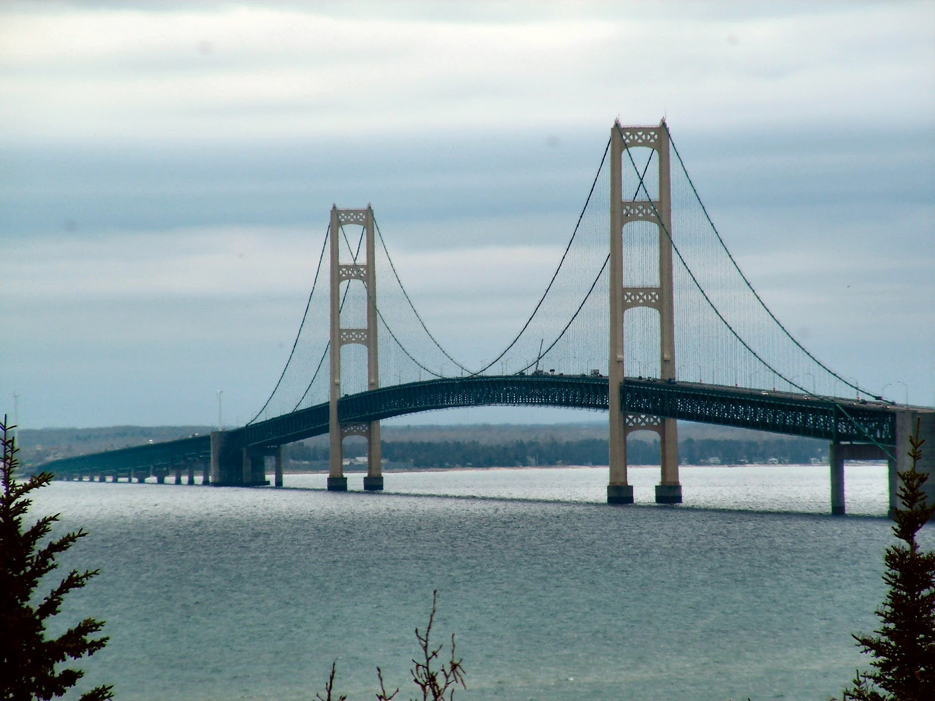
Comparison
The Mackinac bridge longer than the Akashi Kaikyo by 13,541 feet

Slide 5
Researched and Produced by Vibha 2nd Grade Buck Lake Elementary Tallahassee, FL 2019

